Slide 1
The Need for Self-Assembly
Earlier we discussed Microfabrication:
A method for simultaneously making large numbers of IC / MEMS devices
It's very efficient and very cost-effective . . .
But use of projected light images → Sizes > λ_{light} (deep UV ~ 0.05 micron)
In our last class I described methods of making things MUCH smaller
Atomic Force Microscope writing oxide patterns or melting polymer pits
Scanning Tunneling Microscopes pushing atoms . . .
Electron Beams patterning photographic emulsions
But new techniques often fell on wrong side of science vs. technology boundary
Key figure (introduced in lecture 5) was:
A Hands-on Introduction to Nanoscience: WeCanFigureThisOut.org/NANO/Nano_home.htm

Slide 2
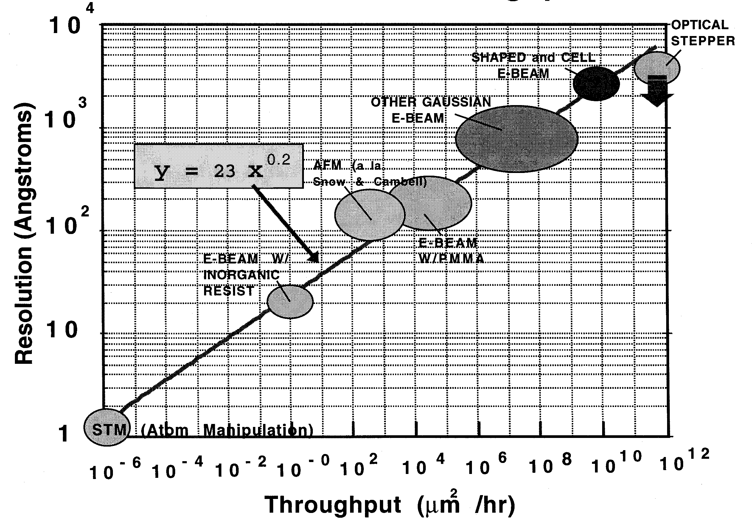
Processing rate vs. lithography and its best resolution
Source: Don Tennant of Bell Labs
E-beam lithography
Photolithography
AFM lithography
STM lithography
- 1/100 seconds
Processing time for 5x5 mm²
1/10,000 the area single Si wafer
- 3000 Years
- 30 Years
- 3 billion years
- 25 Hours

Slide 3
Producing a dilemma:
Microfabrication: Efficient but crude (on the nanoscale)
Nanofabrication using AFM or STM: Precise, but lifetime of universe to pattern one wafer
These are now often described as "Top Down Fabrication" techniques
TOP DOWN in that we 10⁹ X larger humans are trying to directly control everything
That is, top down in a management sense
TOP DOWN in that we often start with LARGE things and try to whittle them smaller
E.G. microfabrication's deposition of whole layers → etch away unwanted portions
Alternative? "Bottom Up Fabrication"
A Hands-on Introduction to Nanoscience: WeCanFigureThisOut.org/NANO/Nano_home.htm

Slide 4
Bottom Up Fabrication
1) START with nanoscale things
Researchers have made a LOT of progress with this
2) Then try to find a way to get them organized in useful ways
But here we are still on a steep leaning curve!
Focusing on the second more difficult step, this bottom up process is also called:
SELF - ASSEMBLY
(That is: Figure out a way to get mother nature to do the hard part)
Nanoscale self-assembly has been going on for BILLIONS of years
Challenges are to figure: WHERE it has been going on (we can't SEE it directly)
Which forms of self-assembly might be useful

Slide 5
SELF-ASSEMBLY (most often) = Lower energy through organization
1) Trivial case – only one possible end state:
Start: Finish:
2) More realistic – many possible end states (but one slightly favored):
Start: Finish:
A Hands-on Introduction to Nanoscience: WeCanFigureThisOut.org/NANO/Nano_home.htm

Slide 6
Or helped by catalysts and enzymes ("Semi Self-Assembly?")
3) CATALYSTS: GUIDE parts toward final LOWER ENERGY state:
Start:
Intermediate:
Finish:
4) ENZYMES: DRIVE pieces to state that may even be at HIGHER ENERGY
Using force/energy provided by enzyme (e.g., fueled by ATP → ADP)
As occurs with many forms of DNA and protein "self-assembly"
A Hands-on Introduction to Nanoscience: WeCanFigureThisOut.org/NANO/Nano_home.htm

Slide 7
Looking more deeply:
Say that we want to "grow" (i.e. self-assemble) more of the structure at the left:
Ideally, new piece arrives at "perfect" multi-bonding attachment point
More complicated (but realistic) scenario:
New piece arrives at more weakly bound position
Then jumps until it
reaches "perfect" point
This takes more time, especially because jump DIRECTION is likely RANDOM:
SO new piece actually wanders about until it STUMBLES upon "perfect" point

Slide 8
Sounds like that might take a heck of a long time!
What it actually takes is a whole lot of jumps (for wandering to finally pay off)
So elapsed time depends on time per jump (or jump frequency)
Relevant quantity is atomic vibration frequency = "Debeye Frequency"
Because some fraction of vibrations ( ) produce jumps ( )
But Debeye frequencies are HUGE:
For Silicon (at ~ 400°C)** ~ 2-20 THz (i.e. 2-20 x 10¹² times per second)
Debeye vibrational frequencies are even HUGE at 25°C !
AS TEMPERATURE INCREASES: Vibrational frequency AND amplitude increase
becomes = increasing jumps
Implying, instead, that self-assembly could progress VERY rapidly!
** Reference: https://courses.cit.cornell.edu/ece407/Lectures/handout21.pdf

Slide 9
But there are other potential problems:
What happens if a second piece arrives too soon?
First piece alights between "atoms"
Given a short bit of time it would wiggle over to full bonding position
But before that can occur,
second piece arrives to sit atop it
Self-assembly is getting into big trouble:
First piece is now buried, no longer independent, semi-locked into (wrong) position!

Slide 10
SELF-ASSEMBLY STRATEGY #1:
SLOW DOWN, reducing arrival rates, giving each new piece time to settle in
How do you "reduce arrival rates?"
- In self-assembly from solution, reduce concentration of reactants
- In self-assembly from gas, reduce partial pressures of reactants
TURN UP THE TEMPERATURE, so that things "settle in" faster
Because vibrations and jumps will then all happen more quickly
It's like doing everything in "fast forward"
SELF-ASSEMBLY STRATEGY #2:

Slide 11
Another Oops: Piece that is accommodated in alternative arrangement
What we'd expected (or hoped for): But at only slightly higher energy (nearly as likely):
Leading to assembly we'd hoped for:
Or something VERY different:

Slide 12
Key to dealing with this is exploitation of REVERSIBILITY
Temperature driven vibrations and jumps continuously . . .
ARRANGE AND REARRANGE:
ASSEMBLE AND DISASSEMBLE:
OR:
A Hands-on Introduction to Nanoscience: WeCanFigureThisOut.org/NANO/Nano_home.htm

Slide 13
So things that are "done" are also being continuously "undone"
But lower energy configurations are "undone" less frequently / readily (they're more stable!)
IDEAL would be sudden loss of stability with increasing temperature:
TEMPERATURE
T₂
SWEET SPOT
T₁ < T < T₂
ONLY #2 Stable
T₁
STABLITY of #2
STABLITY OF #1
A Hands-on Introduction to Nanoscience: WeCanFigureThisOut.org/NANO/Nano_home.htm

Slide 14
Unfortunately things are not quite that simple
Generally, regions of stability and instability do not have sharp temperature boundaries
That can be played against each other to promote certain structures
Stability is instead PROBABILISTIC, governed by "Arrhenius" / "Boltzmann" / "Fermi" behavior:
That is, involving factors like: e ^{– E1 / k T}
Yielding probability plots of stability similar to this (for E2 > E1):
100%
Probability that #2 is stable
Probability that #1 is stable
SELF-ASSEMBLY STRATEGY #3: Stay in SWEET-ish Zone
(where Prob #2 >> Prob #1)
Temperature

Slide 15
And then there are impurities to deal with:
"Impurity" = anything else you really hadn't planned on being present:
Disrupted structure:
Whole new structure:
OR:
SELF-ASSEMBLY STRATEGY #4: Get rid of almost all impurities
Sometimes possible with self-assembly from gas (i.e., some forms of crystal growth)
Hopeless with aqueous growth (i.e., chemistry, where must later refine out mistakes)
SELF-ASSEMBLY STRATEGY #5: Again try to find a "SWEET-ish" temperature zone
But this time where only impurity bonding becomes unstable

Slide 16
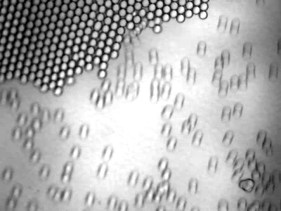
TIME FOR SOME EXAMPLES: Crystal growth of glass microspheres
Supporting webpage with embedded animation:
The Need for Self-Assembly - Supporting Materials - Animation_1
Source: Interdisciplinary Education Group, NSF MRSEC project of the University of Wisconsin.
http://www.mrsec.wisc.edu/Edetc/cineplex/self/text.html
A Hands-on Introduction to Nanoscience: WeCanFigureThisOut.org/NANO/Nano_home.htm

Slide 17
That was a less than perfect example of self-assembly:
With MANY faults in the crystal (involving 0.1 to 1% of “atoms”):
Faults
Impurities
In semiconductor crystals, fewer than 1 in 10¹² atoms can be out of place!!
So what was the problem with above crystal growth?
New atoms arrived way TOO quickly
Allowing no time for: Crystal to expel impurity atoms
Or to try to repair flawed crystal
In this case obvious solution = Turn down flux / Dilute concentration of reactants
A Hands-on Introduction to Nanoscience: WeCanFigureThisOut.org/NANO/Nano_home.htm

Slide 18
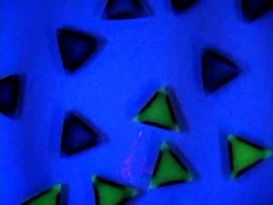
Another visualization of self-assembly: floating magnetized shapes
Crystal growth / self-assembly of floating plastic magnets:
Supporting webpage with embedded animation:
The Need for Self-Assembly - Supporting Materials - Animation_2
Note how it takes many tries to find the ideal / lowest-energy configuration
Facilitated by agitation (background energy) to knock it out of less desirable states
Source: Interdisciplinary Education Group, NSF MRSEC project of the University of Wisconsin.
http://www.mrsec.wisc.edu/Edetc/cineplex/self/text.html
A Hands-on Introduction to Nanoscience: WeCanFigureThisOut.org/NANO/Nano_home.htm

Slide 19
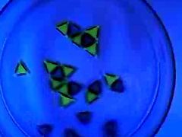
But this time we didn’t get much overall crystal growth!
Problem? Too much energy
Triangles briefly condensed - but then jumped back off
But this DID have side advantage: It grew almost no “Bad” mis-bonded crystal
Mis-bonded atoms were held so weakly that they re-evaporated VERY fast
Solution for this: Slow things down = Reduce temperature of the system
A Hands-on Introduction to Nanoscience: WeCanFigureThisOut.org/NANO/Nano_home.htm

Slide 20
Confirming earlier self-assembly strategies:
Best self-assembly almost always produced by a subtle optimization of temperature and flux:
Temperature:
Low temperatures: Easier to reach, less likely to liberate impurities from elsewhere,
and may best preserve desirable features of assembly
Moderate temperatures: Help newly arrived parts to quickly reach proper sites
High temperatures: Make it less likely that undesirable impurities will stick
or that more energetic arrangements will persist
Flux (or flow):
Higher the flux, faster the parts already on surface must get into proper positions
So higher fluxes require use of higher growth temperatures
But higher flux does make presence of ambient impurities less important
Because they then constitute smaller fraction of arriving parts (atoms)
A Hands-on Introduction to Nanoscience: WeCanFigureThisOut.org/NANO/Nano_home.htm

Slide 21
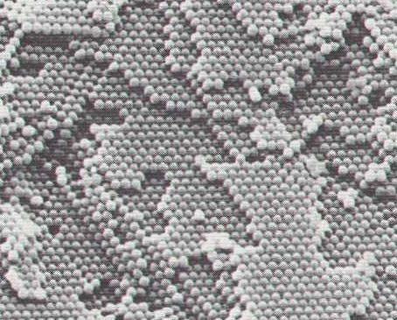
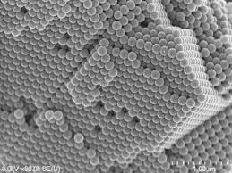
A neat example of naturally occurring self-assembly:
One that I only recently learned about!
Water, percolating down through rocks, leeches out (dissolves) silica (SiO₂)
If the water then begins to dry up
Silica becomes supersaturated, and precipitates back out of solution
Under the right conditions, silica precipitates form uniform spheres, 100's of nm in diameter
If drying/precipitation is slow enough, spheres have time to get organized
First into sheets: And, eventually, into full 3D structures:

Slide 22
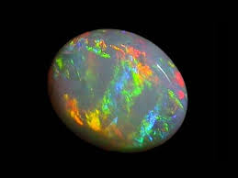
When 3D regions grow into one another, you get the gemstone OPAL!
Which is treasured for its "iridescent colors" (= colors that shift with viewing angle)
All because of Wave Diffraction!
Spheres are about the size of light's wavelength so they scatter light
Which adds constructively for one color (wavelength), in one direction
Or adds constructively for another color (wavelength), in another direction
A Hands-on Introduction to Nanoscience: WeCanFigureThisOut.org/NANO/Nano_home.htm

Slide 23
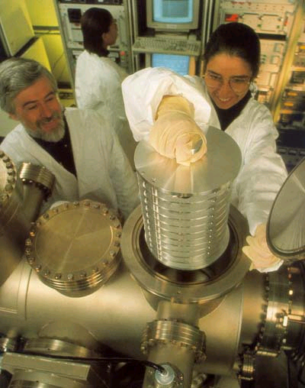
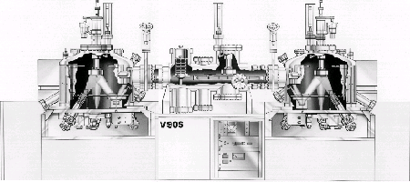
In the lab, I did something similar with individual atoms via:
"Molecular Beam Epitaxy" (MBE)
Throw individual atoms across vacuum chamber (by evaporating them)
Let them land on mildly heated substrate (which allows them to still move around)
Arriving atoms ➔
<= Migrating atoms
But it takes 1M$ plus worth of vacuum equipment to make it this "simple"
My homepage view: My full two growth chamber system:
Arrow marks point where photo at left was taken

Slide 24
OK, but where's the beef nano?
Sure, "MBE" involves nano atoms, but how does this produce nano structures?
Flip upside down, install TWO evaporation sources, then alternate atoms:
Viola!
Single atom layers!
A Hands-on Introduction to Nanoscience: WeCanFigureThisOut.org/NANO/Nano_home.htm

Slide 25
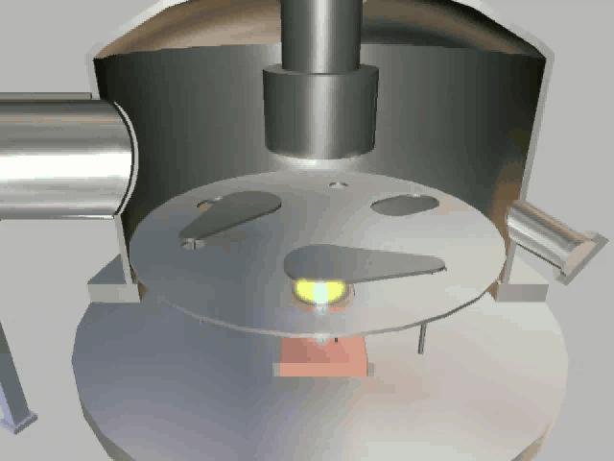
Or more realistically:
Supporting webpage with embedded animation:
The Need for Self-Assembly - Supporting Materials - Animation_3
From WeCanFigureThisOut.org: https://WeCanFigureThisOut.org/VL/MBE.htm
A Hands-on Introduction to Nanoscience: WeCanFigureThisOut.org/NANO/Nano_home.htm

Slide 26
But what if you want 3D nano-structures?
Try with atoms of different sizes: Smaller Si atoms and larger Ge atoms
Alternative #1: Larger Ge atoms squeeze to fit = Strained Layer Epitaxy ¹
Alternative #2: Arriving atoms exploit their surface mobility to segregate / island:
Favored at lower temperatures
Favored at higher temperatures
1 Strained Layer Epitaxy of Germanium-Silicon Alloys, John C. Bean,
Invited Review, Science Magazine 230, 127-131 (1985)

Slide 27
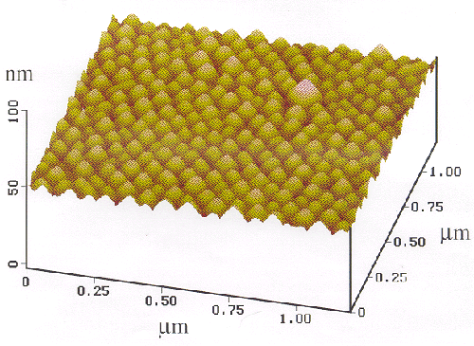
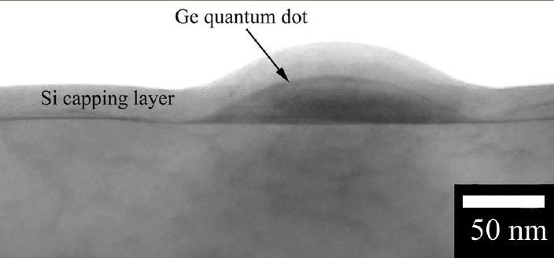
Really do get such spontaneous 2D self assembly:
AFM image of slightly organized MBE Germanium islands on Silicon
(Stress-Induced Self-Organization of Nanoscale Structures in SiGe/Si Multilayer Films, C. Teichert, L.J. Peticolas, J.C. Bean, J. Tersoff and M.G. Lagally, Physical Review B 53 (24), 16334-7, 1996)
TEM cross-section of MBE Germanium island embedded in Silicon
"Analysis of the 3D relationship of Ge quantum dots in a Si matrix using focused ion beam tomography" A.J. Kubis, T.E. Vandervelde, J.C. Bean, D. Dunn, R. Hull, Nanoparticles and Nanowire Building Blocks-Synthesis, Processing, Characterization and Theory. 2p. 411 (2004), Materials Res. Soc.

Slide 28
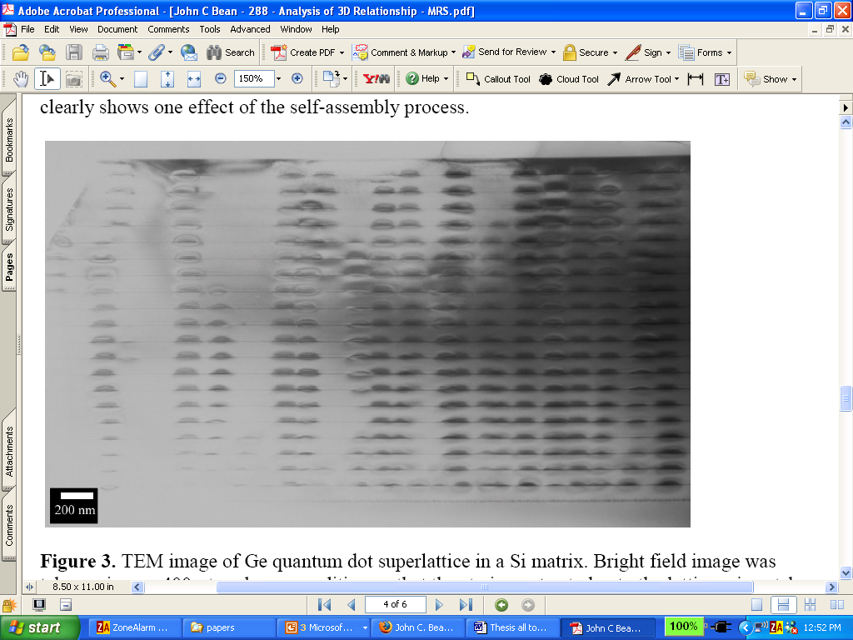
And this led to an even more complex 3D self-assembly:
TEM Cross-section of MANY layers of self organizing Ge dots embedded in Si:
"Analysis of the 3D relationship of Ge quantum dots in a Si matrix using focused ion beam tomography" A.J. Kubis, T.E. Vandervelde, J.C. Bean, D. Dunn, R. Hull, Nanoparticles and Nanowire Building Blocks-Synthesis, Processing, Characterization and Theory. 2p. 411 (2004), Materials Res. Soc.
What you are seeing is this:
Ge islands growing atop Ge islands, growing atop Ge islands . . . WHY?
A Hands-on Introduction to Nanoscience: WeCanFigureThisOut.org/NANO/Nano_home.htm

Slide 29
Explanation comes from variation of earlier figure:
Bulging Ge island on Si:
Stretches Si layer deposited above it:
And so on and so on . . .
Attracting next layer of Ge atoms:
Explanation first published in: Stress-Induced Self-Organization of Nanoscale Structures in SiGe/Si Multilayer Films, C. Teichert, L.J. Peticolas, J.C. Bean, J. Tersoff and M.G. Lagally, Physical Review B 53 (24), 16334-7, 1996
A Hands-on Introduction to Nanoscience: WeCanFigureThisOut.org/NANO/Nano_home.htm

Slide 30
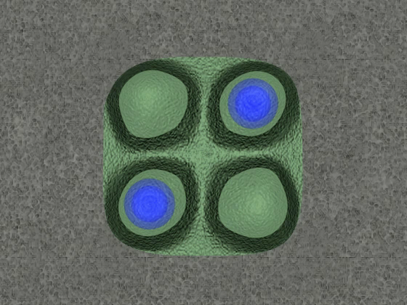
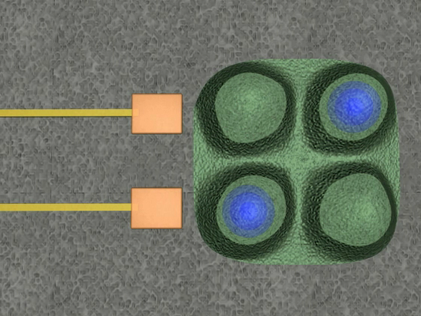
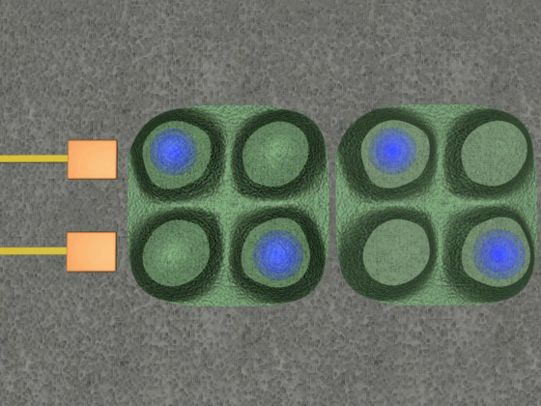
Device-relevant forms of self-assembly?
Consider proposal for nanoscale Quantum Cellular Automata:
Square array of Q-dots
with affinity for electrons
So small & close (~30 nm) that charges repel
End up only holding two charges
Two alternate charging
patterns => Digital 1 and 0!
Which can be manipulated
by input signal on wire.
And charge configuration
will then propagate along
a "wire" of such QCA
elements!
Supporting webpage with embedded animation:
The Need for Self-Assembly - Supporting Materials - Animations_4_6
(Source: WeCanFigureThisOut.org https://wecanfigurethisout.org/VL/QCA_cells.htm)
A Hands-on Introduction to Nanoscience: WeCanFigureThisOut.org/NANO/Nano_home.htm

Slide 31
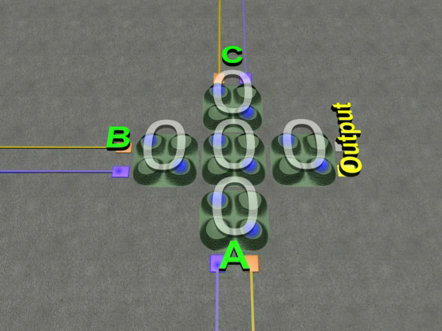
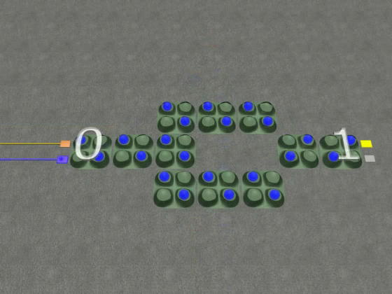
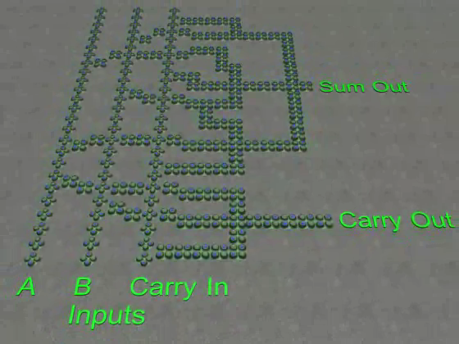
Self-assembled QCA’s could be used in digital logic gates:
QCA Majority, AND, OR gate
QCA Inverter
QCA Binary Adder!
(Source: WeCanFigureThisOut.org https://wecanfigurethisout.org/VL/QCA_logic.htm)
I’ll explain how these digital devices work in my Nanoelectronics lecture
Today’s question is: Can we con mother nature into self-assembling QCA’s?
Well, we’ve made a good start:
A Hands-on Introduction to Nanoscience: WeCanFigureThisOut.org/NANO/Nano_home.htm

Slide 32
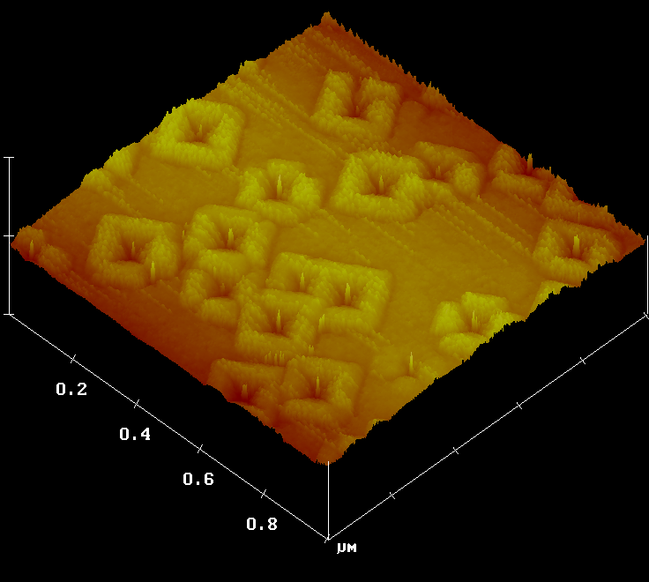
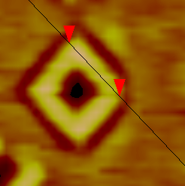


Self-assembled QCA dot like structures:
AFM image of MBE grown GeSi “quantum fortresses”
P. Kumar, T.E. Vandervelde, T. Kobayashi, J.L.Gray, T. Pernell, J. A. Floro, R. Hull, J.C. Bean, Applied Physics Letters 83, 5205-7 (2003)
Higher resolution top views of QF's grown under slightly different conditions:
Self-assembled QCA?
A Hands-on Introduction to Nanoscience: WeCanFigureThisOut.org/NANO/Nano_home.htm

Slide 33
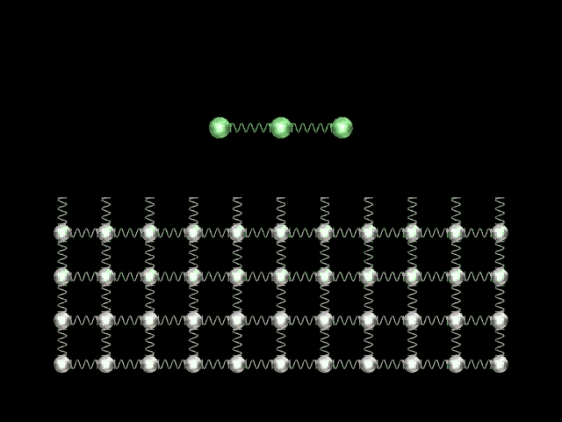
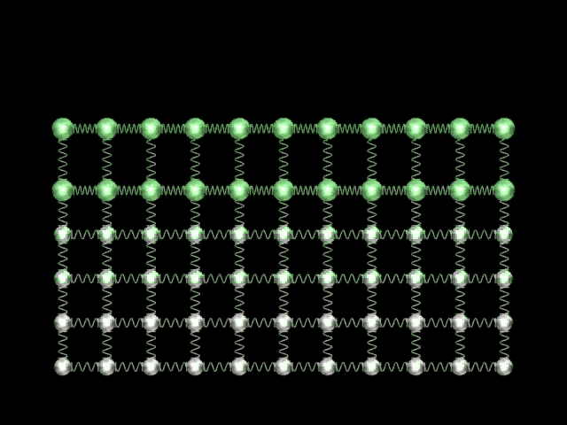
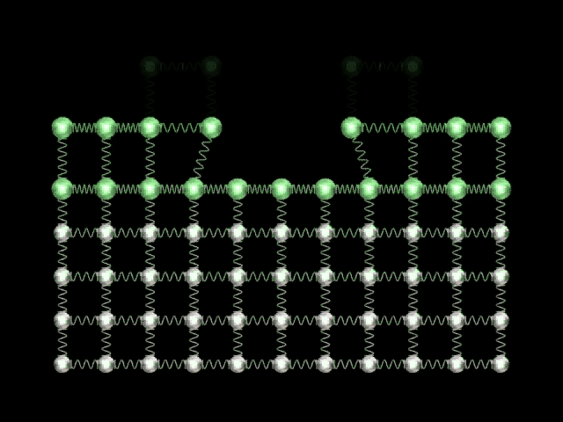
How on earth did you get nature to do this?
Supporting webpage with embedded animation:
The Need for Self-Assembly - Supporting Materials - Animations_10_12
A Hands-on Introduction to Nanoscience: WeCanFigureThisOut.org/NANO/Nano_home.htm

Slide 34
Other unique forms of crystal self-assembly?
Heat metal dot on Si until melts.
Immerse in vapors of SiH₄.
Si dissolves into molten metal (forming eutectic)
Then precipitates
onto Si surface
Now switch from SiH₄ to GeH₄ vapor:
A Hands-on Introduction to Nanoscience: WeCanFigureThisOut.org/NANO/Nano_home.htm

Slide 35
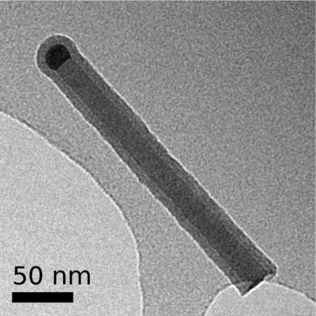
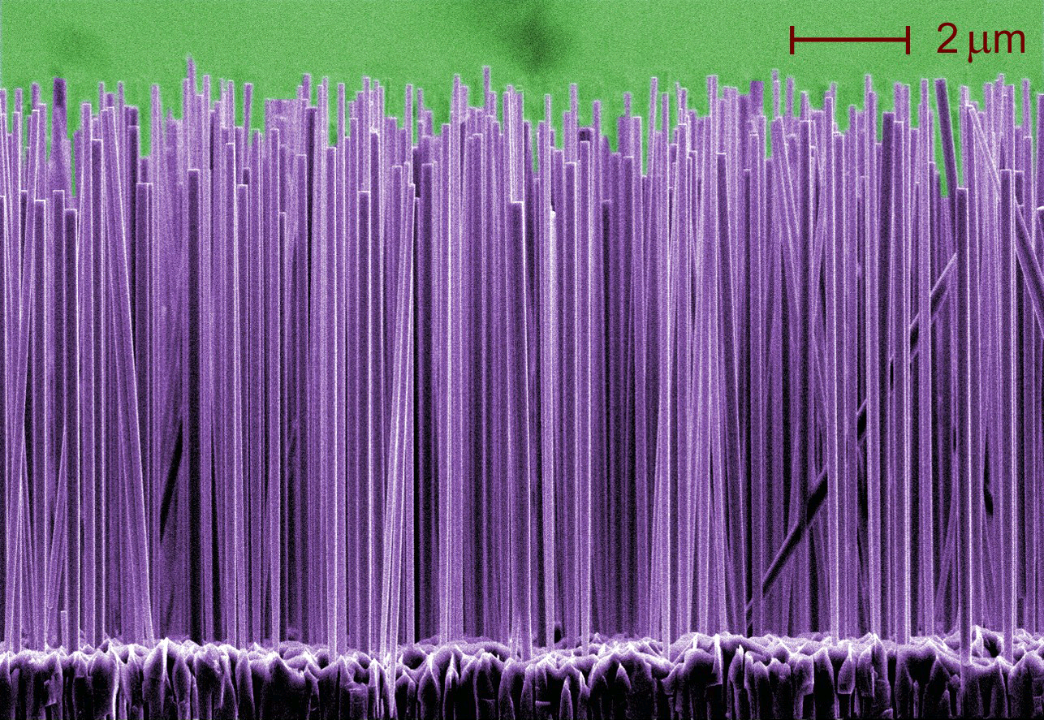
Are you pulling our leg? No:
Lorelle Mansfield -NIST:
http://www.nist.gov/public_affairs/techbeat/tb2006_0525.htm
U. Helsinki: www.micronova.fi/units/ntq/research/nanowires.php
Switch back and forth between gases:
Switch gases after metal removed:
Or do both!
A Hands-on Introduction to Nanoscience: WeCanFigureThisOut.org/NANO/Nano_home.htm

Slide 36
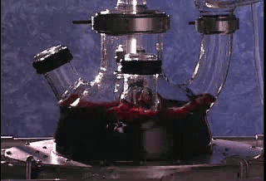
Or how about self-assembly of gold nano particles:
From CytImmune Inc:
Supporting webpage with embedded animation:
The Need for Self-Assembly - Supporting Materials - CytImmune
A Hands-on Introduction to Nanoscience: WeCanFigureThisOut.org/NANO/Nano_home.htm

Slide 37
What exactly did he do?
Basic Process:
Put gold chloride (HAuCl₄) into solution liberating Au⁺ ions
Added sodium citrate "reducing agent" that de-ionizes the gold: Au⁺ => Au
Some Au atoms then start to clump together into sub nanometer nuclei
Remaining Au atoms then pile on => almost uniform Au nanoparticles
Size = 5 to 100 nm depending on gold chloride to sodium citrate ratio
OR can controllably enlarge nanoparticles in second process:
Put above particles into fresh HAuCl₄ solution (creating new supply of Au⁺ ions)
"Reduce" driving those ions to coat old nanoparticles, enlarging them
A Hands-on Introduction to Nanoscience: WeCanFigureThisOut.org/NANO/Nano_home.htm

Slide 38
Is self-assembly ALL about crystal growth?
ABSOLUTELY NOT! In fact I am running out of crystal growth examples
There are more numerous and more powerful examples in the wet world
A small sampler (with much more to follow in subsequent lectures):
Consider the peculiar properties of water:
Oxygen wants electrons much more than hydrogen
So charge distribution in water is not uniform - Molecule is "polarized"
H
H
O
A Hands-on Introduction to Nanoscience: WeCanFigureThisOut.org/NANO/Nano_home.htm

Slide 39
Which means that water molecules like to organize (sort of):
As liquid water jostles about, molecules tend to place (+) hydrogens next to (-) oxygens on neighbor
Energy reduced as opposite charges snuggle closer
“HYDROGEN BONDING”
(When solidifies, REALLY gets organized - Why it expands)
Screwed up if big non-polarized molecules (e.g. oils) inserted into mix:
Oils hold water molecules apart So oil and water tend to segregate
"A Hands-on Introduction to Nanoscience: WeCanFigureThisOut.org/NANO/Nano_home.htm

Slide 40
But what if add polarized end group to oil?
Then water IS attracted to ends:
Or even better:
Long molecules organize:
Hydrophillic (water loving) ends aligned in same direction
Becomes the low energy interface with the water
A Hands-on Introduction to Nanoscience: WeCanFigureThisOut.org/NANO/Nano_home.htm

Slide 41
Use in complex self-assembly?
Float layer of oily molecules on top of water bath
Move surface barrier inward to compress oil layer
Monitor surface tension by the pull on a sheet partially immersed in bath to sense when oils "self-assemble" side to side
A Hands-on Introduction to Nanoscience: WeCanFigureThisOut.org/NANO/Nano_home.htm

Slide 42
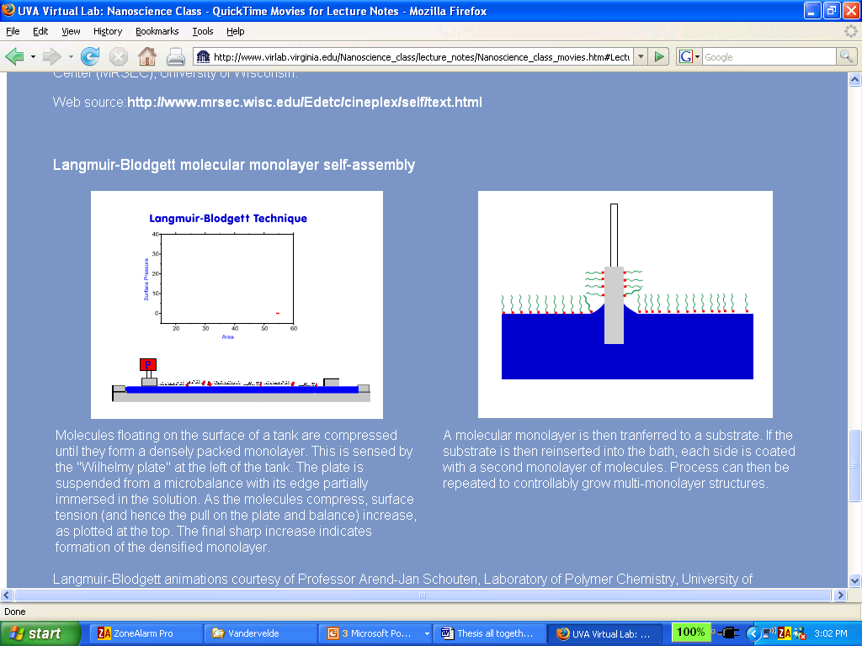
Its called "Langmuir-Blodgett" film growth:
Courtesy of Professor Arend-Jan Schouten, Laboratory of Polymer Chemistry, University of Groningen, The Netherlands: http://polchajs.fmns.rug.nl/files/jv/lb.html
A Hands-on Introduction to Nanoscience: WeCanFigureThisOut.org/NANO/Nano_home.htm

Slide 43
But there is an even better molecular arrangement!
Organize oils with special polarized
ends so that they are tail to tail:
Called a "lipid bilayer" - Ring a bell?
Both sides of film are now "hydrophillic" so it's happy to be immersed in water:
(OK, so I got tired of orienting dozens of tiny water molecules!)
A Hands-on Introduction to Nanoscience: WeCanFigureThisOut.org/NANO/Nano_home.htm

Slide 44
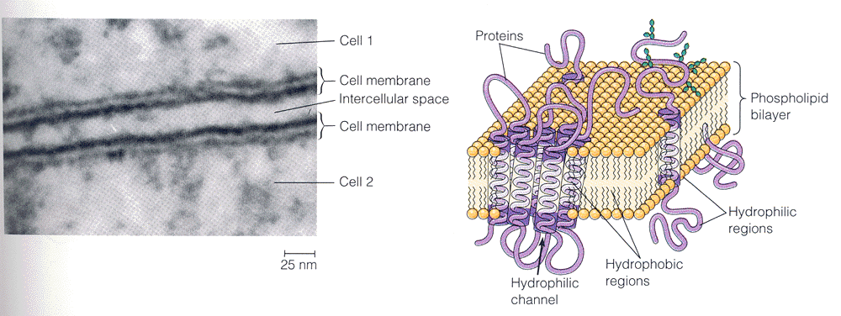
Which gives . . . a cell membrane!
Which is constructed out of exactly such a “lipid bilayer” layer
And does not actually involve atomic bonding BETWEEN the lipid molecules!
Source: The World of the Cell, W.M. Becker, J.B. Reece and M.F. Poenie, Benjamin/Cummings Publishing, 3rd edition, page 27
A Hands-on Introduction to Nanoscience: WeCanFigureThisOut.org/NANO/Nano_home.htm

Slide 45
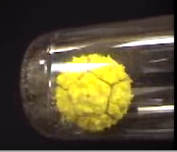
But how does nature actually assemble such things?
Demonstration of how a virus shell might assemble:
Uses plastic subunits with embedded magnets to simulate bonding
From the Molecular Graphics Laboratory of Professor Arthur J. Olson of the Scripps Institute
http://mgl.scripps.edu/projects/tangible_models/movies
Supporting webpage with embedded animation:
The Need for Self-Assembly - Supporting Materials - Animation_15
A Hands-on Introduction to Nanoscience: WeCanFigureThisOut.org/NANO/Nano_home.htm

Slide 46

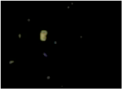
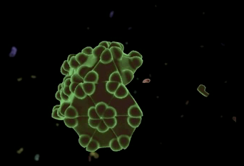
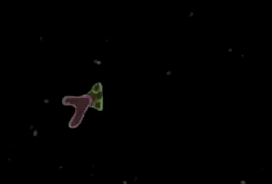
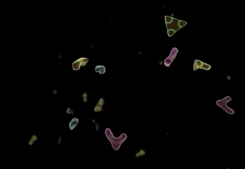
Or via computer animation:
From the “Auto Cell Project”
Shows not only how molecular fragments might assemble, but how their assembled structure would then produce more of the ingredient fragments!
Supporting webpage with embedded animation:
The Need for Self-Assembly - Supporting Materials - Animations_16_19
A Hands-on Introduction to Nanoscience: WeCanFigureThisOut.org/NANO/Nano_home.htm

Slide 47
But there is much more than mere atomic/molecular self-assembly!
To really get into PROGRAMMED self-assembly we need to learn about:
Organic chemistry → DNA Replication → Et Cetera
Topics of lectures to follow!!
A Hands-on Introduction to Nanoscience: WeCanFigureThisOut.org/NANO/Nano_home.htm

Slide 48
Credits / Acknowledgements
Funding for this class was obtained from the National Science Foundation (under their Nanoscience Undergraduate Education program).
This set of notes was authored by John C. Bean who also created all figures not explicitly credited above.
Copyright John C. Bean
(However, permission is granted for use by individual instructors in non-profit academic institutions)
A Hands-on Introduction to Nanoscience: WeCanFigureThisOut.org/NANO/Nano_home.htm

